Slide 1



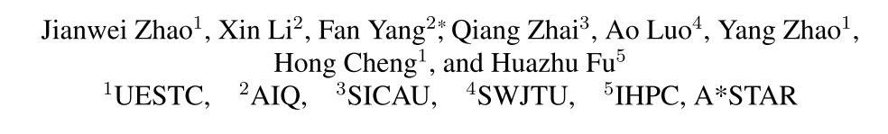





Chongqing University of Technology
ATAI
Advanced Technique of Artificial Intelligence
Chongqing University of Technology
MExD: An Expert-Infused Diffusion Model for Whole-Slide Image Classification
Code：thttps://github.com/JWZhao-uestc/MExD
—— CVPR 2025
Reported by Jing Li

Slide 2
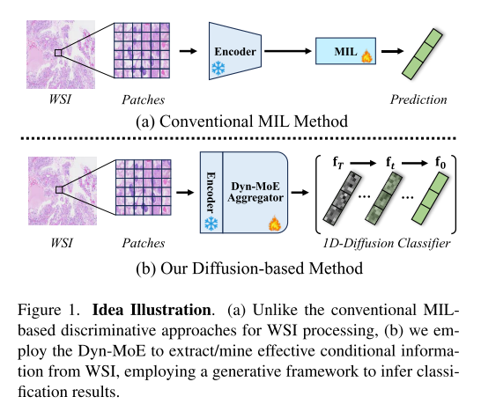
Motivation
1.Breaking down WSIs into manageable patches to extract features and then com-bining them into a final representation for classification. A significant issue is data imbalance: within a bag, positive instances are often vastly outnumbered by negative ones.This imbalance can bias the model toward the majority class, leading it to overlook or misclassify important minority instances

Slide 3
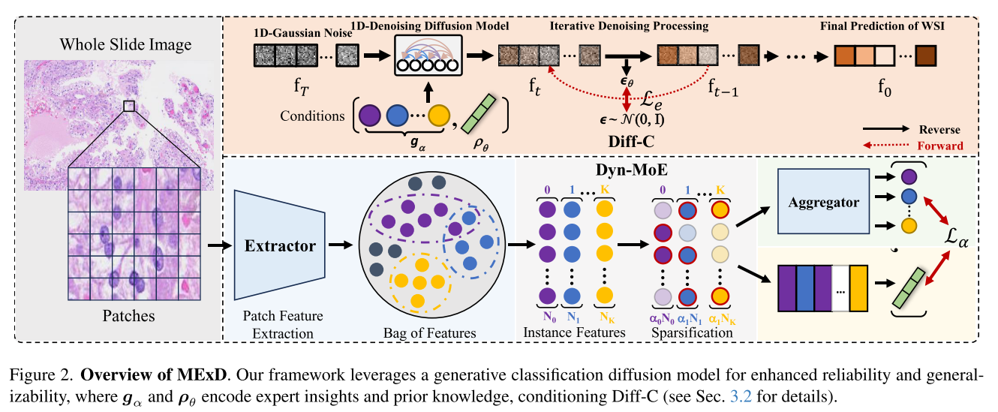
Method

Slide 4
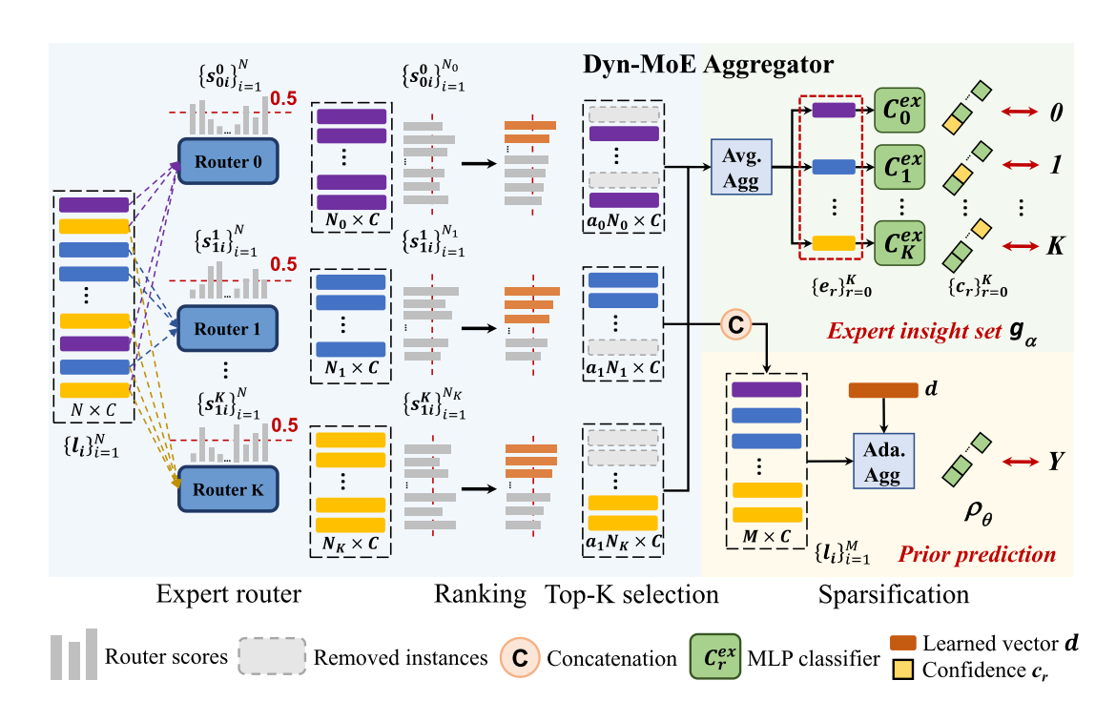
Method

Slide 5
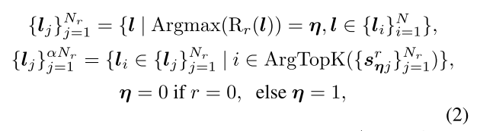


Method

Slide 6
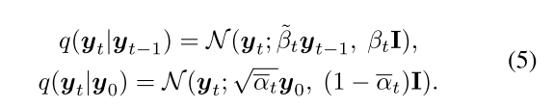
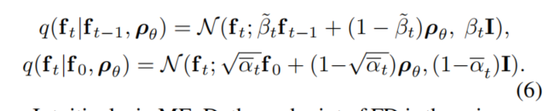

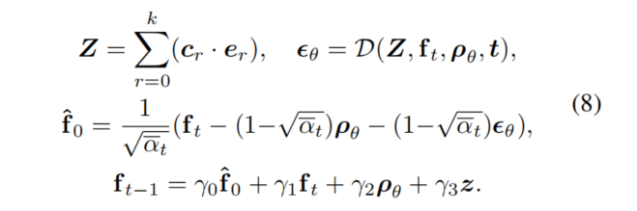
Method

Slide 7
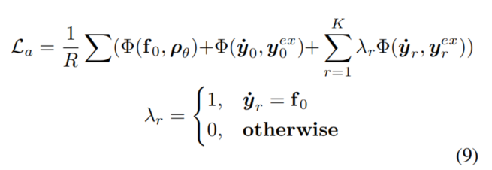

Method

Slide 8
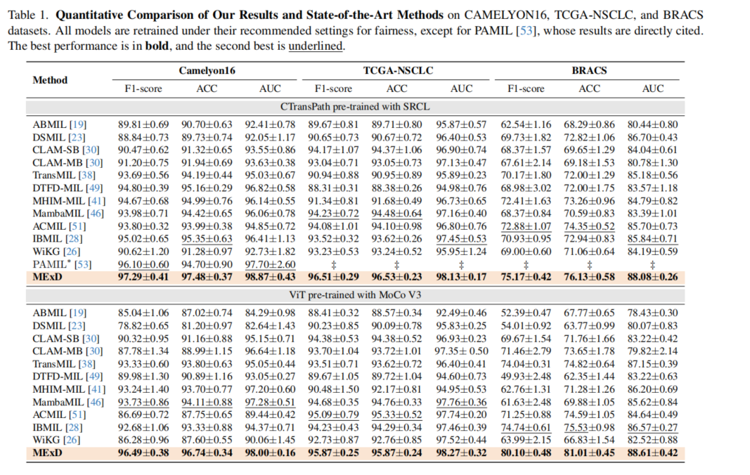
Experiments

Slide 9
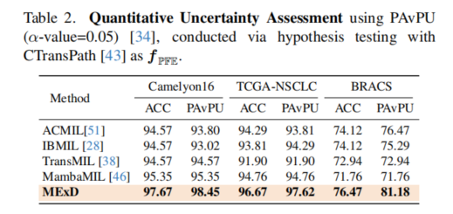
Experiments

Slide 10
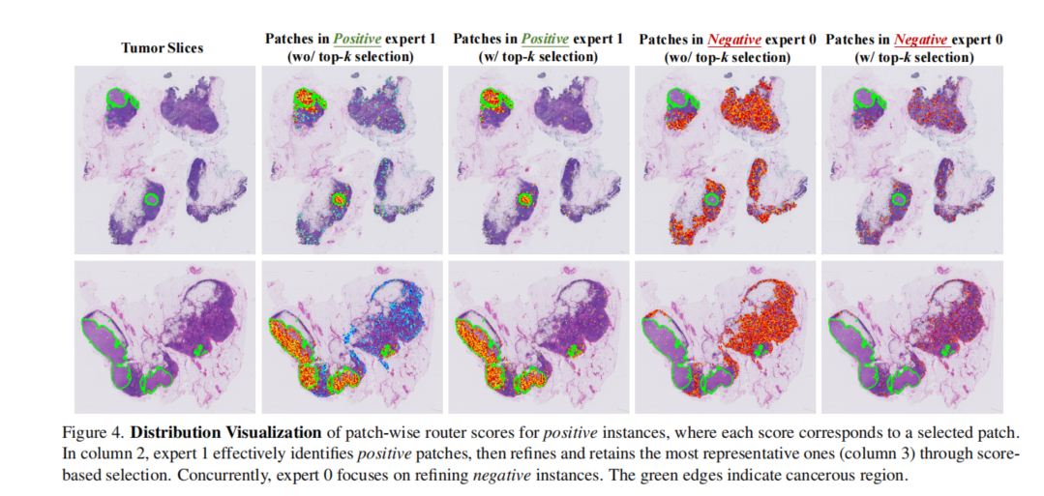
Experiments

Slide 11
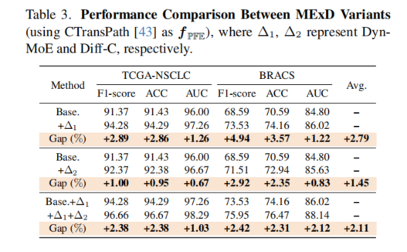
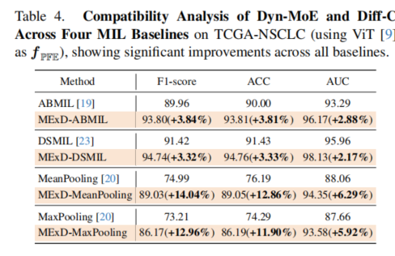
Experiments

Slide 12
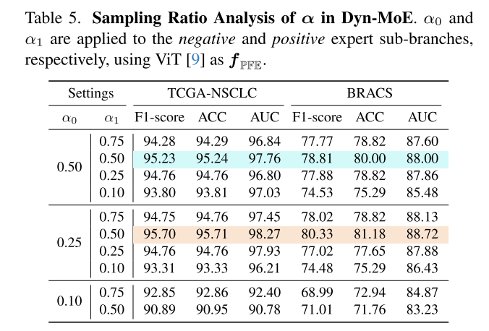
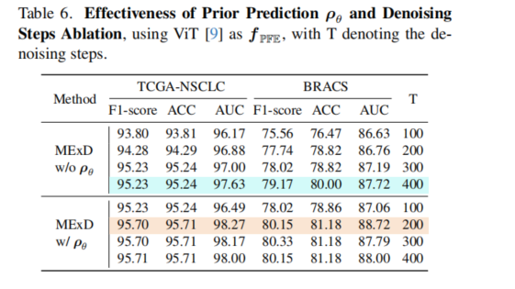
Experiments

Slide 13
Thanks!

